Slide 1
Project 3 Proposal:
iLaundry
By: Shivani Dere & August St. Louis

Slide 2
Concept & Scenario
Scenario: In a hotel room, there is a need to bring new customers new bathroom materials. There is also a constant need to store dirty clothes somewhere without there actually being any space for them
Introducing… iLaundry.
Concept: This robot will take dirty clothes from the guests, bring them to a washing machine, and dispose then pick them back up after completion.

Slide 3
How it works?
Main component: Basket.
There is a IR sensors on the bottom of the basket.
When the IR sensor on the bottom of the basket is triggered, the basket will be transported to the laundry and will dump the cloths from the basket into the laundry.

Slide 4
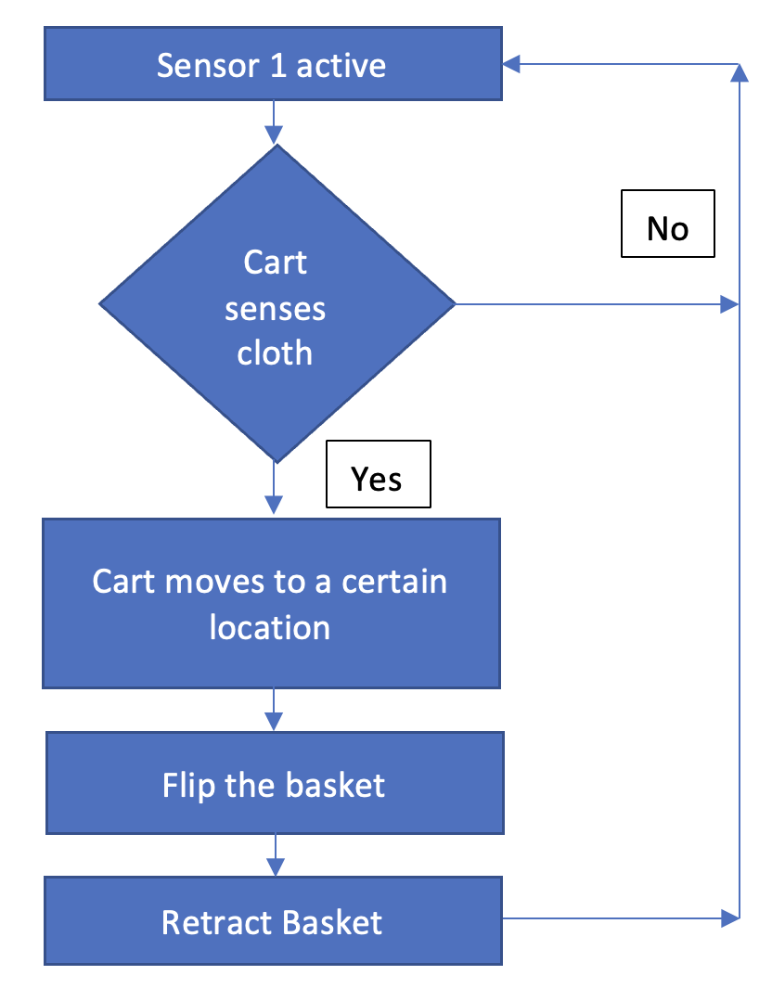
Robot Workflow

Slide 5
Engineering the Concept
IR Sensors: Detects the presence of new materials being placed inside the robot: Triggers the algorithm to start.
Servo Motors: Utilized to raise and lower and surface as needed.
Basket: Will contain dirty cloths when inserted. It has a type of transportation mechanism (wheels). It is used to dump cloths, when the user puts the cloths in the
cart.

Slide 6
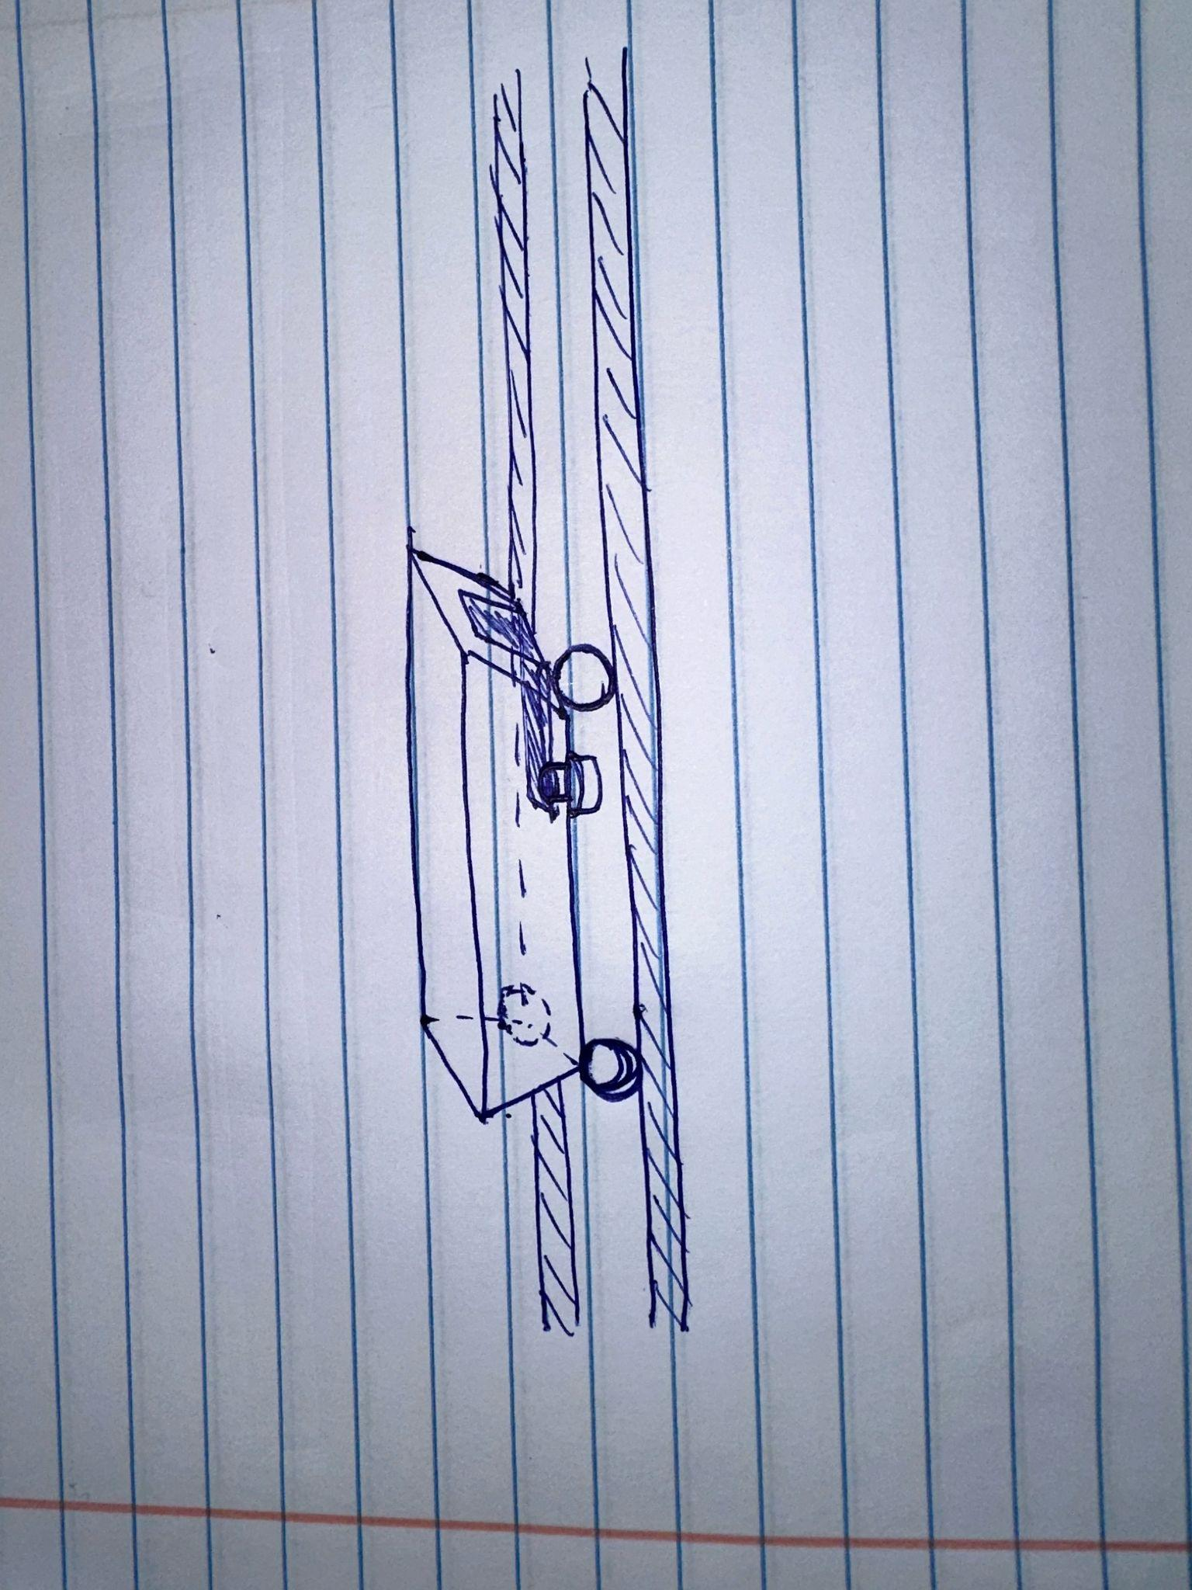
Initial Sketches

Slide 7
Potential Components
Arduino
Servo shield
IR Sensor
Servo Motors
Miscellaneous 3D Printed Components
GitHub Repository
Nails/fasteners
Track for robot vehicles
Wheels/transportable components

Slide 8
Thank you!

